Slide 1
Front End Engineering-I Project
Team Details:
Rajat Sharma Roll no.2210990707
Rajiv kuwar Roll no.2210990708
Rajkirat Singh Roll no.2210990709
Raj Vardhan Rollno.2210990710
Faculty Coordinator:
:
Chitkara University Institute of Engineering and Technology,
Chitkara University, Punjab

Slide 2
Table of Contents
Introduction
Problem Statement
Technical Details
Key Features
Project Highlights
Bonus Feature(optional)
Conclusion
References/Links used

Slide 3
Introduction
Topic:-Exit The Plugin
Team Members:-
1-Rajkirat Singh Roll no.2210990709
2-Rajat Sharma Roll no.2210990707
3-Raj Vardhan Tiwari Roll no.2210990710
4-Rajiv kuwar pal Roll no.2210990708
Overview:-The purpose of "exit the plugins" is to capture the attention of visitors who are about to leave a website and persuade them to take some kind of action, such as subscribing to a newsletter, making a purchase, or following the website on social media. These plugins use various triggers, such as mouse movement or clicks, to detect when a user is about to leave the site and display a popup message or offer. Additionally, they can provide valuable insights into visitor behaviour and preferences, which can be used to optimize the website and improve overall performance.

Slide 4
Problem Statement
" Exit the plugins " aim to solve the problem of low engagement on websites by providing a last-minute opportunity for visitors to take action before leaving the site. When visitors leave a website without taking any action, it can result in missed opportunities and lost revenue for the website owner. By detecting when a visitor is about to leave the site and displaying a targeted message or offer, these plugins aim to increase engagement and conversions, ultimately resulting in higher revenue and a better return on investment for the website owner.

Slide 5
Technical Details
Technologies and Methods used are :
JavaScript: JavaScript is a programming language that is commonly used to create dynamic and interactive web pages. It is often used to create the popups and triggers used in “Exit Intent Popup Plugins.”
HTML and CSS: HTML and CSS are used to structure and style the popup window and its contents. They are used to create the layout and appearance of the popup, including text, images, and buttons.

Slide 6
Key Features
Exit intent detection: The ability to detect when a visitor is about to leave the site is the key feature of "Exit Intent Popup Plugins." This is typically done through mouse movement tracking, with the plugin detecting when the cursor moves towards the top of the screen or towards the "back" button.
Customizable popup design: "Exit Intent Popup Plugins" typically offer a range of customizable design options, allowing users to create popups that match their website's branding and style.
Targeted messaging: Popups can be customized to display targeted messages or offers based on a range of factors, such as visitor behaviour, location, or referral source.
Analytics and reporting: "Exit Intent Popup Plugins" often provide detailed analytics and reporting on visitor behaviour, such as the number of popups displayed, the click-through rate, and conversion rates.

Slide 7
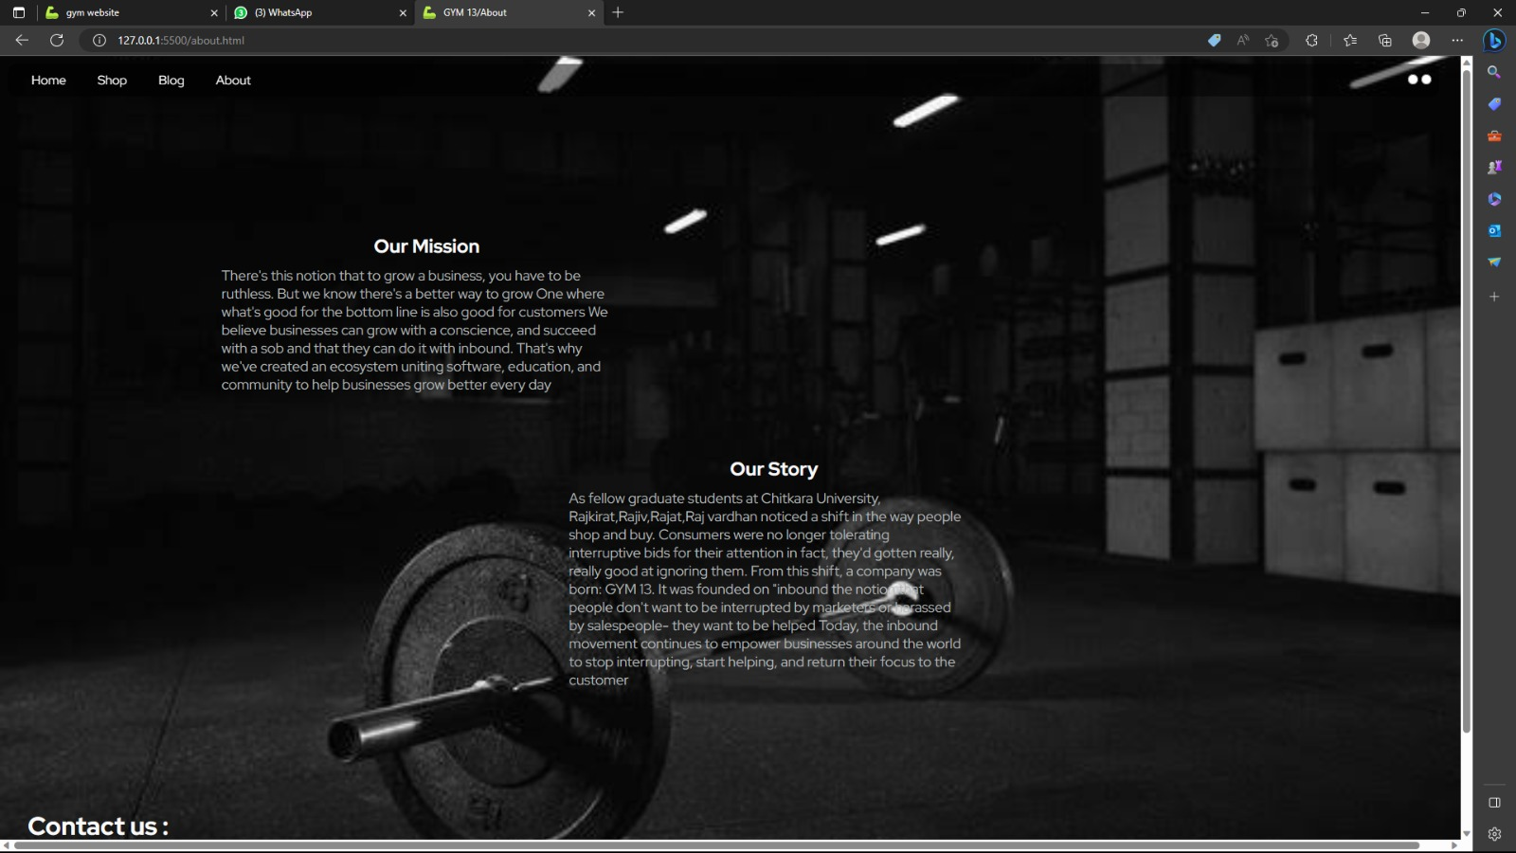
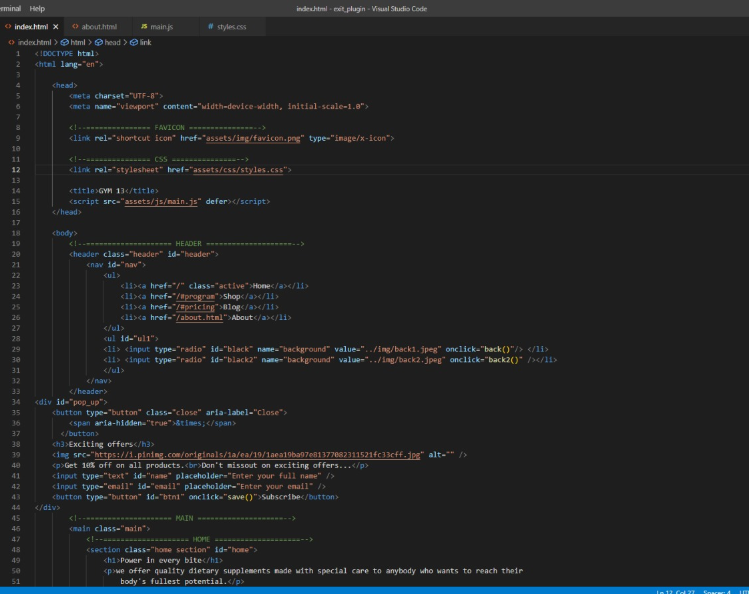
Project Highlights

Slide 8
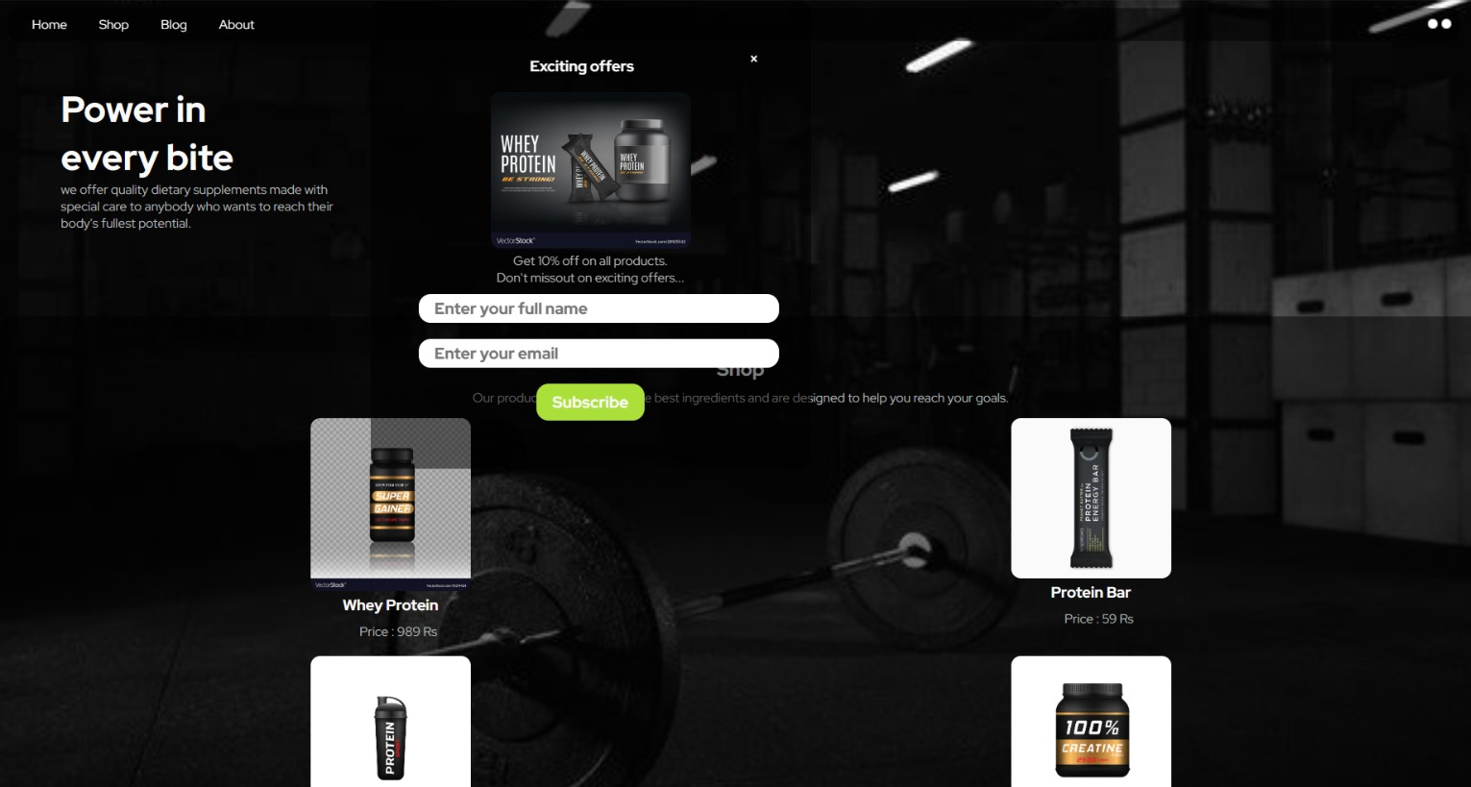

Slide 9
Conclusion
In conclusion, "Exit Intent Popup Plugins" can be an effective tool for website owners to reduce bounce rates, increase conversions, and provide a better user experience for their visitors. By detecting when a visitor is about to leave the site and displaying targeted messages or offers, "Exit Intent Popup Plugins" can encourage visitors to take action and engage with the site. They also offer a range of customization options and insights into visitor behaviour and preferences, allowing website owners to optimize their marketing strategies and improve overall performance. However, it is important to use "Exit Intent Popup Plugins" thoughtfully and strategically, as overuse or inappropriate use can negatively impact the user experience and result in decreased engagement and conversions.

Slide 10
References/Links used
MDN Web Docs
https://developer.mozilla.org
W3Schools Online Web Tutorials
https://www.w3schools.com

Slide 11


